Slide 1


Slide 2

Online Marketplace Net
The Online Marketplace Net is a place where you can catch bargains from your favourite store online!
Or you can sell your own products in your very own store!

Slide 3
Online Marketplace Net
Project Overview
The App will be with have these main features:
Users with Seller accounts, Shop Management, Product Management, Product search by name and category, Shopping cart, Stripe payments, Creating orders, Viewing orders, Listing orders by shops, Auctions in a real-time bidding with socket.IO, viewing auctions.
A complete marketplace online!
Notes:
An App that is a clone of eBay, provides the same services as it.

Slide 4
Online Marketplace Net
The user story:
The ability to buy and sell in an online marketplace setting has become a core requirement for many web platforms and businesses.
The motivation:
I wanted to create something useful, modern and in everyday life online, the ability to buy or sell anything you wanted and that I could use.
Furthermore to this, I wanted to challenge myself and put myself in a complicated position with a short deadline and complicated tasks and to be under pressure the whole time.
This allowed me to understand my strengths & my weakness, my determination and my capacity to keep self-motivated and utter will to continue and finalize the project against all odds.
Notes:
This was a very important part of the whole idea of the marketplace.
As I really wanted a challenge and to put myself on the spot light.
The journey was amazing but I am excited to go for my next one and
The one after that one.

Slide 5
Online Marketplace Net
Technologies:
Using the MERN. MongoDB, Express, React & Node,
For the app, I used new technologies/dependencies as well as some packages. Some of these are jsonwebtoken, formidable, helmet, query-string, lodash, cookie-parser and others. For some of these, I spent lot of reading and watching you tube tutorials on how to use them and deploy these. (For a complete list go to ANNEX A)
Notes:
jsonwebtoken, Was the most complicated to implement and understand.
Formidable: A node.js module for parsing form data, especially file uploads.
HELMET: Helmet helps you secure your Express apps by setting various HTTP headers
query-string: Parse and stringify URL query strings
LODASH : Lodash makes JavaScript easier by taking the hassle out of working with arrays, numbers, objects, strings, etc.Lodash’s modular methods are great for:
Iterating arrays, objects, & strings
Manipulating & testing values
Creating composite functions
Cookie-Parser: Parse Cookie header and populate req.cookies with an object keyed by the cookie names. Optionally you may enable signed cookie support by passing a secret string, which assigns req.secret so it may be used by other middleware.

Slide 6
Online Marketplace Net
Challenges:
I encountered 3 major obstacles in the development of the app;
The first one was the amount of work to be completed to have the basic layout and authentication working. I lost 5 days to the authentication, but to be fair in timewise, I started the project 1 week before and was struggling already with the JWT/OAUTH. Got it to work.
The second big struggle came in the form of using React components, as these became complicated and then had to connect the front-end to the back-end. And with 44 files front-end, it become close to the end of my sanity. These numbers increased when included Auction feature and so did my insanity
The 3rd and biggest issue I encountered was to enable Stripe, a form of payment system and after getting it to work partially, I had to completely park it and hard-code one of the parts of the app.
(Edit: I got this @#%@ working! MUAHAHAHAHAHAHAHAHAAHAHAH cough cough ZZzzzzzzzzzzzzzzzzzzzzzzz)
Notes:
I read for hours of documentation of all the dependencies involved and tested dozen of examples,
Which non worked. By the way. When I started with 4 files of the front end, which was one controller, one modal and one route for the user on the back-end,
multiplied by 4 in a few days and then by 4 again, I ended up fixing a controller that was working thinking it was another one, and lost few hours just to realize
That Product.js is different than Products.js
With Stripe, I learned something valuable. Never Give Up!
When Augustin, kindly replied to me on a Sunday to either fix the strip or drop it, I decided to drop it,
On the following Monday, I had a chat with Dyon and Scottie, and felt miserable, and told myself, I never give up, why am I now?
And that night, I was able to get the strip working.

Slide 7
Online Marketplace Net
Lessons Learned
Planning saved me many headaches, but also caused many others. As initially my plan was much smaller and simpler than the result, which in turn gave me some well-deserved headaches.
Also, I learned that in order to succeed is to know one's limitations and I am sure that if I did not try, I would not know what I really knew and what I had to learn to overcome the challenges I faced.
The incalculable value of using the Kanban, written notes, documentation & drawings of what I wanted helped me in the long run to identify the things, that would require more work and had to be dropped in a To-Do features.
I also realized, that I can keep going no matter what, I kept on going and enjoyed every minute of it.
Notes:
I made plenty notes, many drawings, many ideas, that did make in but many more that were discarded.
Thankfully I followed through, with planning, or I would have not been able to keep my mental health in check,
I used Kanban a the beginning a lot, but at the end, I tried to keep up, but time was pressing.

Slide 8

Online Marketplace Net
Success Story
I am proud of what I have achieved, despite the result. As every challenge I was faced, was a new opportunity to learn and grow. When I realized the magnitude of the project, I did not panic and kept on going chipping away in small chunks as told, by Agustin.
When all seem lost and out of control, I was able to devise a walkaround to either bypass or resolve the issue.
The best success story for me was one day at 3 am, when I realized that I was troubleshooting a broken feature on the wrong folder!! When I tested it on the correct one it was working, I actually fixed it and ran the npm run dev on the wrong VsCode, I could not stop laughing.
Notes:
As mentioned earlier slides, It has been a tough hard insanely tiring 3 weeks!
I made so many mistakes, as missing comas, or curly brackets that VSCode did not even see it as an issue,
Then do tons of console.logs and hunt down the issue and google the messages and nothing made much sense most of the time.
I made it through!

Slide 9
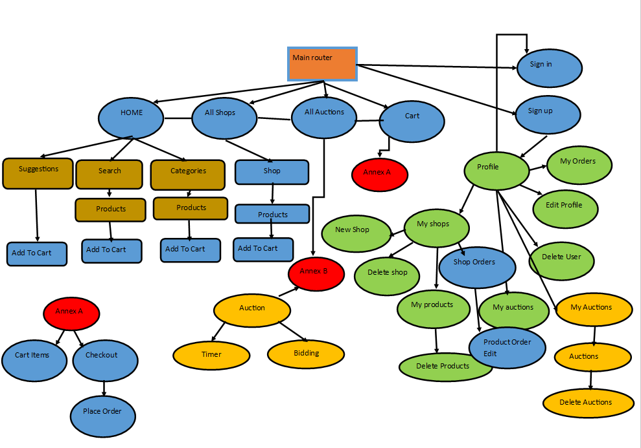
Online Marketplace Net
Front-end tree diagram React components and views
Notes:
This Tree shows a bit of how I started the process.
The blue were the initial views or flows that I wanted or needed in the app.
As well as the Green which ended up complicated and took a lot of time.
I ended up adding the dark gold color then the light orange.
There might be some missing, but I had to remake this as I cannot find the original one.

Slide 10
DEMO
Notes:
Time for the demo, well as you can see, this is what you would expect from a market place portal.
I will create one new user, and with this user, I will be just a buyer, and purchase some products and go tot the end of the process.
Then I will log into one user who is a seller and has a store, and products already uploaded,
Here we can see the order made and we can change the status as delivered, processing, which currently its not working, as it’s a test account with stripe and no payments are made. But the flow is as you can see. The users can see the status updated on their profile view.

Slide 11
Online Marketplace Net
The Future
I plan on finalizing this app by adding new features, these are a few that will make it in the next project:
Facebook Login
Google Login
PayPal
Auction system (Edit: I got this %$@#$ to work!)
Creating phone App version as this is a browser version. (Edit: Already in progress.)
Creating a centralized theme so to be able to make the app reusable to different customers & countries
Also enabling a switch to translate to most used languages.
Enabling an admin panel to manage currency which currently is hardcoded.
Notes:
There is much to add that would enhance the app, as logging in with your Facebook, google and Linkedin accounts,
And using other pay system as Paypal, Already have some code ready to implement, and did a tests which failed, so it was removed.
I am always thinking how to automate things and make it easy the second time, I would need to implement this and there is a lof improvements in this area,
For instance the theme used:, So creating a centralized theme so to be able to make the app reusable to different customers, countries & languages.
Using variables that can use the localization of the computer used to offer translation with a click of a switch.
Also, creating an Admin panel, that would allow users to manage currency which currently is hardcoded to their country of origin.

Slide 12
Online Marketplace Net
ANNEX - A
DevDependencies:
@babel/core
@babel/preset-env
@babel/presert-react
Babel-loader
File-loader
Nodemon
Webpack
Webpack-cli
Webpack-dev-middleware
Webpack-hot-middleware
Webpack-node-externals
Dependencies:
@hot-loader/react-dom
@material-ui/core
@material-ui/icons
Compression
cookie-parser
Cors
Express
express-jwt
Formidable
jsonwebtoken
lodash
mongoose
query-string
React
React-dom
React-hot-loader
React-router
React-router-dom
Helmet
React-stripe-elements
Request
Socket-io
Socket.io-client
stripe
Notes:
All the dependencies used for the project.

Slide 13
Online Marketplace Net
ANNEX - B
Coding (cont)
https://www.youtube.com/watch?v=mBd-SMPp3kI&pbjreload=101
https://www.youtube.com/watch?v=oEFPFc36weY
https://www.youtube.com/watch?v=mBd-SMPp3kI
https://www.udemy.com/course/react-the-complete-guide-incl-redux/learn/lecture/8091064#overview
https://www.udemy.com/course/react-nodejs-express-mongodb-the-mern-fullstack-guide/learn/lecture/16851138?start=0#overview
Motivational:
https://www.youtube.com/watch?v=bQxqIKTO2Ck
https://www.youtube.com/watch?v=TFG650qI_C0&t=345s
https://www.youtube.com/watch?v=CR_o8pZNFlY&t=95s
https://www.youtube.com/watch?v=TBuIGBCF9jc
Relax time:
https://www.youtube.com/watch?v=CfqQNjxrLSI
Coding:
https://www.youtube.com/watch?v=zaWtIkJgah4&t=10210s
https://www.youtube.com/watch?v=w1oLdAPyuok
https://www.youtube.com/watch?v=2jqok-WgelI
https://www.youtube.com/watch?v=7Q17ubqLfaM
https://www.youtube.com/watch?v=DPrhem174Ws
https://www.youtube.com/watch?v=996OiexHze0
https://www.youtube.com/watch?v=y0Yq1lPoloo&t=314s
https://www.youtube.com/watch?v=WTUYem2IxLA
https://www.youtube.com/watch?v=0skzNIckrvQ
Notes:
Coding:
This is the main list of Youtube videos that I watch in regards to a marketplace portal.
Also, 2 videos of Maximilian on Udemy, one MERN-FullStack. and the other REACT- The complete guide. Both over 40 hours of videos. Amazing material, honestly.
Relax Time:
When my mind was lost in oblivion looking at endless lines of who knows what at that time, I lay down for 30 minutes listening to that video, works.
Motivational:
And when I lost hope, I was down, tired and giving up every once in a awhile, I would listen to some of these motivational videos, helped me get back up and continue coding.

Slide 14

Online Marketplace Net
Q&A
Your chance to throw at me anything you want!!
Disclaimer:
This project is as it is with no warranty whatsoever, by use or not, or part of the App. If your cat catches on fire and runs to the curtains, which then catches on fire and burns your house down, I will not be held liable in any such form for your loss. Please send me video!
Signed: Me.

Slide 15
Online Marketplace Net
Thank you!
It was a great pleasure and an honor to meet you all
and I wish you all the best success in your future endeavors!
Stay positive, Have courage, And remember there is no such thing as impossible!
We are the proof of this statement!
Thanks to the TA’s and a special thanks to Agustin for his patience and
understanding and great advice and teachings.
See you all some time, someplace!

